Slide 1
CS4705
Part of Speech tagging
Slides adapted from: Dan Jurafsky, Julia Hirschberg, Jim Martin

Slide 2
Garden path sentences
The old dog the footsteps of the young.
The cotton clothing is made of grows in Mississippi.
The horse raced past the barn fell.

Slide 3
What is a word class?
Words that somehow ‘behave’ alike:
  Appear in similar contexts
  Perform similar functions in sentences
  Undergo similar transformations

Slide 4
Parts of Speech
8 (ish) traditional parts of speech
  Noun, verb, adjective, preposition, adverb, article, interjection, pronoun, conjunction, etc
  This idea has been around for over 2000 years (Dionysius Thrax of Alexandria, c. 100 B.C.)
  Called: parts-of-speech, lexical category, word classes, morphological classes, lexical tags, POS
  Lots of debate in linguistics about the number, nature, and universality of these

Slide 5
POS examples
N noun chair, bandwidth, pacing
V verb study, debate, munch
ADJ adjective purple, tall, ridiculous
ADV adverb unfortunately, slowly,
P preposition of, by, to
PRO pronoun I, me, mine
DET determiner the, a, that, those

Slide 6
POS Tagging: Definition
The process of assigning a part-of-speech or lexical class marker to each word in a corpus:
WORDS
TAGS
the
koala
put
the
keys
on
the
table
N
V
P
DET

Slide 7
POS Tagging example
WORD tag
the DET
koala N
put V
the DET
keys N
on P
the DET
table N

Slide 8
What is POS tagging good for?
Is the first step of a vast number of Comp Ling tasks
Speech synthesis:
  How to pronounce “lead”?
  INsult inSULT
  OBject obJECT
  OVERflow overFLOW
  DIScount disCOUNT
  CONtent conTENT
Parsing
  Need to know if a word is an N or V before you can parse
Word prediction in speech recognition
  Possessive pronouns (my, your, her) followed by nouns
  Personal pronouns (I, you, he) likely to be followed by verbs
Machine Translation

Slide 9
Open and closed class words
Closed class: a relatively fixed membership
  Prepositions: of, in, by, …
  Auxiliaries: may, can, will had, been, …
  Pronouns: I, you, she, mine, his, them, …
  Usually function words (short common words which play a role in grammar)
Open class: new ones can be created all the time
  English has 4: Nouns, Verbs, Adjectives, Adverbs
  Many languages have all 4, but not all!
  In Lakhota and possibly Chinese, what English treats as adjectives act more like verbs.

Slide 10
Open class words
Nouns
  Proper nouns (Columbia University, New York City, Sharon Gorman, Metropolitan Transit Center). English capitalizes these.
  Common nouns (the rest). German capitalizes these.
  Count nouns and mass nouns
    Count: have plurals, get counted: goat/goats, one goat, two goats
    Mass: don’t get counted (fish, salt, communism) (*two fishes)
Adverbs: tend to modify things
  Unfortunately, John walked home extremely slowly yesterday
  Directional/locative adverbs (here, home, downhill)
  Degree adverbs (extremely, very, somewhat)
  Manner adverbs (slowly, slinkily, delicately)
Verbs:
  In English, have morphological affixes (eat/eats/eaten)
  Actions (walk, ate) and states (be, exude)

Slide 11
Many subclasses, e.g.
  eats/V ⇒ eat/VB, eat/VBP, eats/VBZ, ate/VBD, eaten/VBN, eating/VBG, ...
  Reflect morphological form & syntactic function

Slide 12
How do we decide which words go in which classes?
Nouns denote people, places and things and can be preceded by articles? But…
    My typing is very bad.
    *The Mary loves John.
Verbs are used to refer to actions, processes, states
  But some are closed class and some are open
  I will have emailed everyone by noon.
  Adverbs modify actions
  Is Monday a temporal adverb or a noun? Some others?

Slide 13
Closed Class Words
Idiosyncratic
Closed class words (Prep, Det, Pron, Conj, Aux, Part, Num) are easier, since we can enumerate them….but
  Part vs. Prep
    George eats up his dinner/George eats his dinner up.
    George eats up the street/*George eats the street up.
  Articles come in 2 flavors: definite (the) and indefinite (a, an)

Slide 14
  Conjunctions also have 2 varieties, coordinate (and, but) and subordinate/complementizers (that, because, unless,…)
  Pronouns may be personal (I, he,...), possessive (my, his), or wh (who, whom,...)
  Auxiliary verbs include the copula (be), do, have and their variants plus the modals (can, will, shall,…)

Slide 15
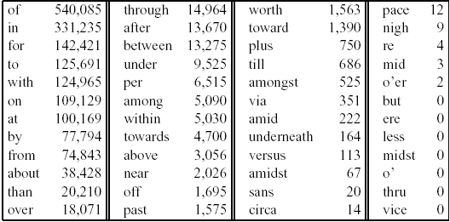
Prepositions from CELEX

Slide 16
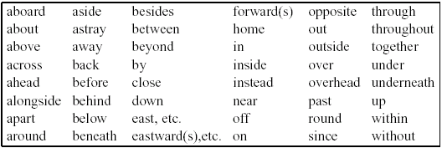
English particles

Slide 17
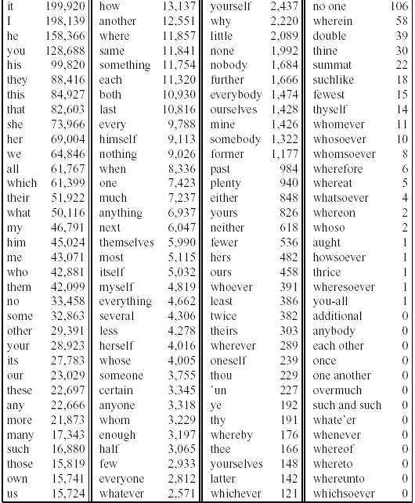
Pronouns: CELEX

Slide 18
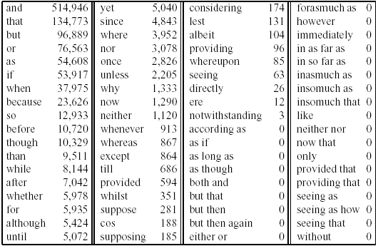
Conjunctions

Slide 19
POS tagging: Choosing a tagset
There are so many parts of speech, potential distinctions we can draw
To do POS tagging, need to choose a standard set of tags to work with
Could pick very coarse tagets
  N, V, Adj, Adv.
Brown Corpus (Francis & Kucera ‘82), 1M words, 87 tags
Penn Treebank: hand-annotated corpus of Wall Street Journal, 1M words, 45-46 tags
  Commonly used
  set is finer grained,
Even more fine-grained tagsets exist

Slide 20
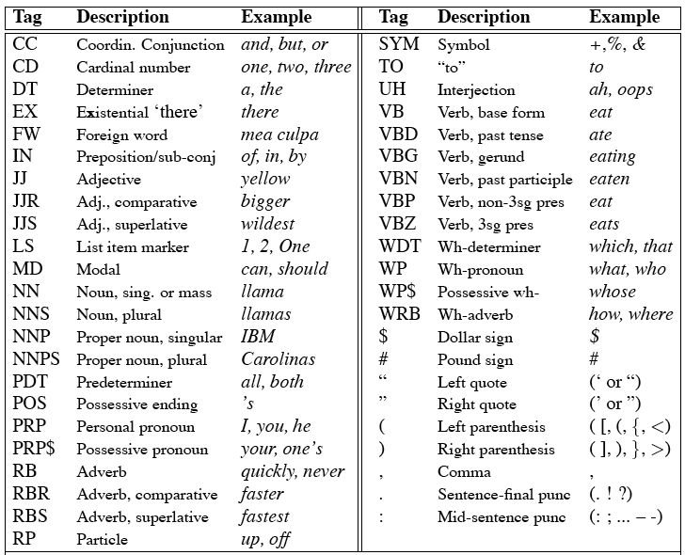
Penn TreeBank POS Tag set

Slide 21
Using the UPenn tagset
The/DT grand/JJ jury/NN commmented/VBD on/IN a/DT number/NN of/IN other/JJ topics/NNS ./.
Prepositions and subordinating conjunctions marked IN (“although/IN I/PRP..”)
Except the preposition/complementizer “to” is just marked “to”.

Slide 22
POS Tagging
Words often have more than one POS: back
  The back door = JJ
  On my back = NN
  Win the voters back = RB
  Promised to back the bill = VB
The POS tagging problem is to determine the POS tag for a particular instance of a word.
These examples from Dekang Lin

Slide 23
How do we assign POS tags to words in a sentence?
  Get/V the/Det bass/N
  Time flies like an arrow.
  Time/[V,N] flies/[V,N] like/[V,Prep] an/Det arrow/N
  Time/N flies/V like/Prep an/Det arrow/N
  Fruit/N flies/N like/V a/DET banana/N
  Fruit/N flies/V like/Prep a/DET banana/N
  The/Det flies/N like/V a/DET banana/N

Slide 24
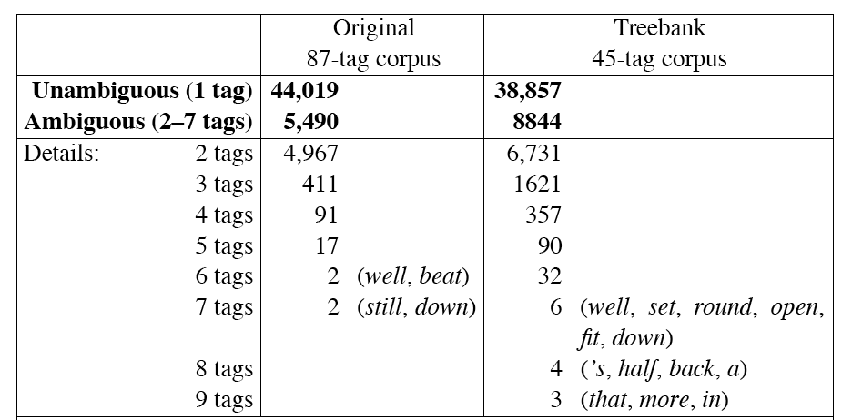
How hard is POS tagging? Measuring ambiguity

Slide 25
Potential Sources of Disambiguation
Many words have only one POS tag (e.g. is, Mary, very, smallest)
Others have a single most likely tag (e.g. a, dog)
But tags also tend to co-occur regularly with other tags (e.g. Det, N)
In addition to conditional probabilities of words P(w₁|w_{n-1}), we can look at POS likelihoods P(t₁|t_{n-1}) to disambiguate sentences and to assess sentence likelihoods

Slide 26
3 methods for POS tagging
Rule-based tagging
  (ENGTWOL)
Stochastic (=Probabilistic) tagging
  HMM (Hidden Markov Model) tagging
Transformation-based tagging
  Brill tagger

Slide 27
Rule-based tagging
Start with a dictionary
Assign all possible tags to words from the dictionary
Write rules by hand to selectively remove tags
Leaving the correct tag for each word.

Slide 28
Start with a dictionary
she: PRP
promised: VBN,VBD
to TO
back: VB, JJ, RB, NN
the: DT
bill: NN, VB
Etc… for the ~100,000 words of English

Slide 29
Use the dictionary to assign every possible tag
NN
RB
VBN JJ VB
PRP VBD TO VB DT NN
She promised to back the bill

Slide 30
Write rules to eliminate tags
Eliminate VBN if VBD is an option when VBN|VBD follows “<start> PRP”
NN
RB
JJ VB
PRP VBD TO VB DT NN
She promised to back the bill
VBN

Slide 31
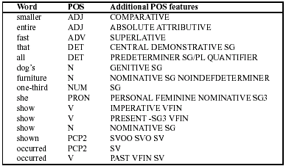
Sample ENGTWOL Lexicon

Slide 32
Stage 1 of ENGTWOL Tagging
First Stage: Run words through FST morphological analyzer to get all parts of speech.
Example: Pavlov had shown that salivation …
Pavlov PAVLOV N NOM SG PROPER
had HAVE V PAST VFIN SVO
HAVE PCP2 SVO
shown SHOW PCP2 SVOO SVO SV
that ADV
PRON DEM SG
DET CENTRAL DEM SG
CS
salivation N NOM SG

Slide 33
Stage 2 of ENGTWOL Tagging
Second Stage: Apply NEGATIVE constraints.
Example: Adverbial “that” rule
  Eliminates all readings of “that” except the one in
    “It isn’t that odd”
Given input: “that”
If
(+1 A/ADV/QUANT) ;if next word is adj/adv/quantifier
(+2 SENT-LIM) ;following which is E-O-S
(NOT -1 SVOC/A) ; and the previous word is not a
; verb like “consider” which
; allows adjective complements
; in “I consider that odd”
Then eliminate non-ADV tags
Else eliminate ADV

Slide 34
Statistical Tagging
Based on probability theory
First we’ll introduce the simple “most-frequent-tag” algorithm
Most-freq-tag is another baseline algorithm.
Meaning that no one would use it if they really wanted some data tagged
But it’s useful as a comparison

Slide 35
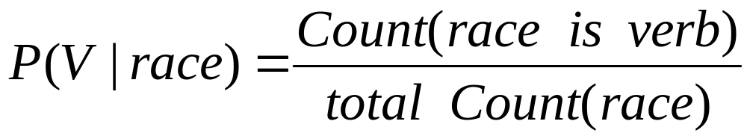
Conditional Probability and Tags
P(Verb) is probability of randomly selected word being a verb.
P(Verb|race) is “what’s the probability of a word being a verb given that it’s the word “race”?
Race can be a noun or a verb.
It’s more likely to be a noun.
P(Verb|race) can be estimated by looking at some corpus and saying “out of all the times we saw ‘race’, how many were verbs?
In Brown corpus, P(Verb|race) = 96/98 = .98

Slide 36
Most frequent tag
Some ambiguous words have a more frequent tag and a less frequent tag:
Consider the word “a” in these 2 sentences:
  would/MD prohibit/VB a/DT suit/NN for/IN refund/NN
  of/IN section/NN 381/CD (/( a/NN )/) ./.
Which do you think is more frequent?

Slide 37
Counting in a corpus
We could count in a corpus
A corpus: an on-line collection of text, often linguistically annotated
The Brown Corpus part of speech tagged at U Penn
Counts in this corpus:
21830 | DT
6 | NN
3 | FW

Slide 38
The Most Frequent Tag algorithm
For each word
  Create dictionary with each possible tag for a word
  Take a tagged corpus
  Count the number of times each tag occurs for that word
Given a new sentence
  For each word, pick the most frequent tag for that word from the corpus.

Slide 39
The Most Frequent Tag algorithm: the dictionary
For each word, we said:
  Create a dictionary with each possible tag for a word…
Q: Where does the dictionary come from?
A: One option is to use the same corpus that we use for computing the tags

Slide 40
Using a corpus to build a dictionary
The/DT City/NNP Purchasing/NNP Department/NNP ,/, the/DT jury/NN said/VBD,/, is/VBZ lacking/VBG in/IN experienced/VBN clerical/JJ personnel/NNS …
From this sentence, dictionary is:
  clerical
  department
  experienced
  in
  is
  jury
  …

Slide 41
Evaluating performance
How do we know how well a tagger does?
Say we had a test sentence, or a set of test sentences, that were already tagged by a human (a “Gold Standard”)
We could run a tagger on this set of test sentences
And see how many of the tags we got right.
This is called “Tag accuracy” or “Tag percent correct”

Slide 42
Test set
We take a set of test sentences
Hand-label them for part of speech
The result is a “Gold Standard” test set
Who does this?
  Brown corpus: done by U Penn
  Grad students in linguistics
Don’t they disagree?
  Yes! But on about 97% of tags no disagreements
  And if you let the taggers discuss the remaining 3%, they often reach agreement

Slide 43
Training and test sets
But we can’t train our frequencies on the test set sentences. (Why not?)
So for testing the Most-Frequent-Tag algorithm (or any other stochastic algorithm), we need 2 things:
  A hand-labeled training set: the data that we compute frequencies from, etc
  A hand-labeled test set: The data that we use to compute our % correct.

Slide 44
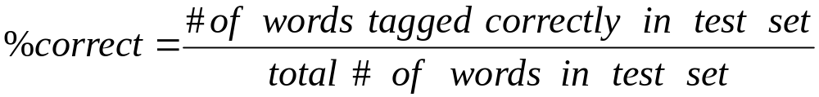
Computing % correct
Of all the words in the test set
For what percent of them did the tag chosen by the tagger equal the human-selected tag.
Human tag set: (“Gold Standard” set)

Slide 45
Training and Test sets
Often they come from the same labeled corpus!
We just use 90% of the corpus for training and save out 10% for testing!
Even better: cross-validation
  Take 90% training, 10% test, get a % correct
  Now take a different 10% test, 90% training, get % correct
  Do this 10 times and average

Slide 46
Evaluation and rule-based taggers
Does the same evaluation metric work for rule-based taggers?
Yes!
  Rule-based taggers don’t need the training set.
  But they still need a test set to see how well the rules are working.

Slide 47
Summary
Parts of speech
  What’s POS tagging good for anyhow?
  Tag sets
  Rule-based tagging
  Statistical tagging
      Simple most-frequent-tag baseline
  Important Ideas
    Evaluation: % correct, training sets and test sets
    Unknown words
  Next time:
    TBL tagging (“Brill tagging”)
    HMM Tagging

